Slide 1
AutoGuardian: Smart Vehicle Anti-Theft System
Pitch Presentation
Nkosiyabo Mdladla • August 8, 2025

Slide 2
The Problem
Vehicle theft is a major issue in South Africa, with thousands of cars stolen each year.
Current systems are expensive and reactive, often only alerting after the theft has occurred.
There is a need for a smart, affordable, and proactive system to stop theft before it happens.

Slide 3

The Solution – AutoGuardian
AutoGuardian is a smart anti-theft system integrating sensors, GSM/GPS, and mobile app control.
It detects suspicious behavior and allows remote immobilization.
Affordable, scalable, and proactive.

Slide 4
How It Works
Sensors detect movement or unauthorized entry.
GSM module sends real-time alerts to your mobile device.
GPS tracks the car's location.
User can disable the car remotely using the app.

Slide 5
Key Features
Real-time alerts
Remote immobilization
GPS tracking
Mobile integration
Affordable hardware setup

Slide 6
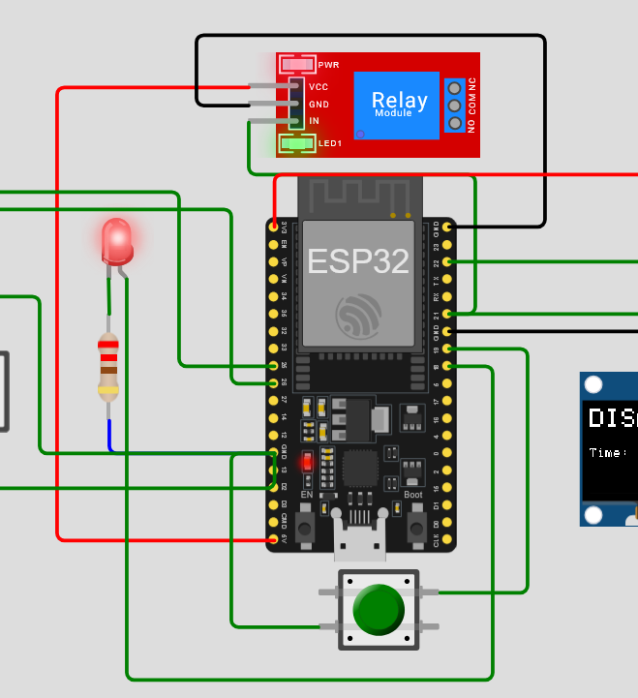
Demo Preview
Wokwi simulation of system logic and alerts

Slide 7
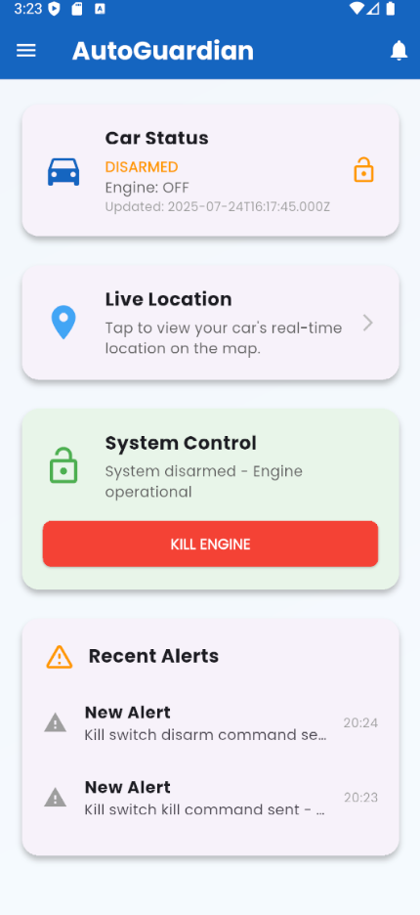
Demo Preview Continued
Mobile app prototype demonstration

Slide 8

Hardware Components Needed
ESP32 microcontroller
GPS module
GSM module (SIM800L)
Motion and tilt sensors
Power module & wiring

Slide 9
Estimated Budget
ESP32: R300
GPS Module: R275
GSM/GPRS Module: R329
1-Channel 5V Relay Module: R130
Sensors: R100 – R150
Miscellaneous (casing, wires): R100
Total: R1600 – R2,700 per unit

Slide 10
Why Sponsor AutoGuardian?
Addresses a major societal problem
High potential for market success
Scalable across Africa
Led by a passionate, skilled student innovator

Slide 11

Thank You
Questions and discussion

